Slide 1
AI Use cases - Mistakes

Slide 2
Cool sites to learn principles of AI/ML
https://teachablemachine.withgoogle.com/
https://www.youtube.com/watch?v=gn4nRCC9TwQ

Slide 3
Domains where AI is used
Medical
Education
Insurance & Banking
Finance & marketing
Quality Control
Regulatory Compliance
Automotive & Manufacturing
Others (Mechanical Engineering, Civil engineering,)

Slide 4
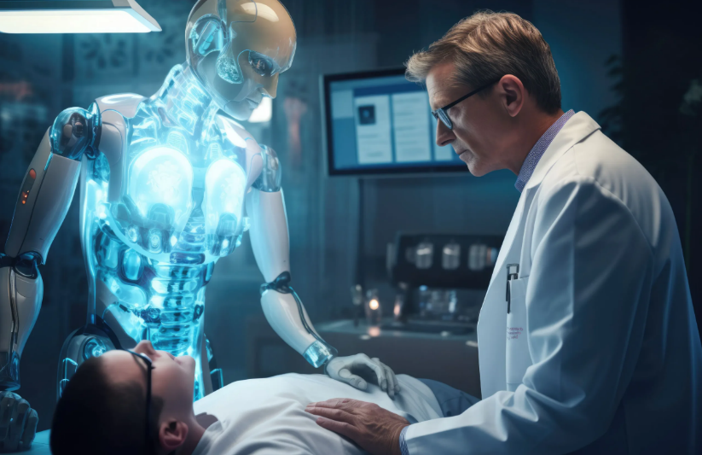
1. Medical
Medical Diagnosis: A doctor cannot remember as much as computer.
Drug Discovery:
Target identification: AI can analyze large amounts of data to find targets that could interact with a drug
Virtual screening: AI can speed up the process of virtual screening by reducing false positives
Predicting drug toxicity: AI can help predict how toxic a drug might be
Clinical trial design: AI can help design clinical trials that are more likely to succeed
Personalized drug dosing: AI can help determine the best dose of a drug for a patient
Drug molecule discovery: AI can help design new drug molecules
Drug-target interaction predictions: AI can help predict how a drug will interact with a target
Patient Experience: Give personalized treatments, etc.
Healthcare Data Management : process and use huge data
Medical Discovery: Life’s chemical building blocks are 20 amino acids. Scientists utilized AI to successfully solve a problem 50 years old problem: predicting the three-dimensional structure of a protein from a sequence of amino acids. This has allowed them to predict the structure of almost all 200 million known proteins. Also developed computerized methods for achieving what many people believed was impossible: creating proteins that did not previously exist and which, in many cases, have entirely new functions.

Slide 5
2. Education
Intelligent tutoring systems: AI-powered tutoring systems leverage algorithms to offer students personalized and real-time feedback. As students engage with learning resources, the AI analyzes their responses, identifies areas of difficulty, and tailors explanations to enhance comprehension. This individualized approach helps bridge gaps in understanding, adapting the learning pace accordingly. By providing immediate assistance and adapting to diverse learning styles, these systems empower students to grasp complex concepts more effectively. The continuous interaction with AI fosters a dynamic learning environment, boosting student confidence and overall academic performance.
Automated grading and assessment: AI streamlines the grading system by analyzing student work and offering swift and consistent evaluations. It lightens educators’ burdens, allowing them to concentrate on personalized guidance.
Chatbots and virtual assistants: AI-driven chatbots and virtual assistants are pivotal in bolstering students’ learning experiences. These intelligent systems offer prompt aid, guiding students through homework tasks, addressing queries, and offering valuable feedback. These tools are available round-the-clock.
Curriculum planning: AI assists in curriculum planning by analyzing educational data to identify trends and gaps in learning outcomes. It can suggest updates and adjustments to curricula based on real-time insights and evolving educational standards.
Proctoring: AI plays a pivotal role in overseeing online exams, effectively curbing cheating and promoting fairness. AI is consistent with all students, so there is no bias. The student can take as many exams/interviews to practice.
Dyslexia detection: offers a valuable solution for the early detection of dyslexia in children who struggle with reading and writing. These youngsters often exhibit difficulties in concentration and irregular eye movements, deviating from the typical left-to-right, top-to-bottom reading pattern. Data can be collected and analyzed by incorporating sensors within the display unit to track eye movements. This data can then be compared to vast datasets stored in a big data repository to assess the degree of attention deficiency promptly. This streamlined approach accelerates the identification process, enabling quicker access to medical and intervention support.
Challenge: High volume of applications and time-consuming manual review. Solution: Automated application screening using AI algorithms to identify qualified candidates based on predefined criteria quickly.
Challenge: Balancing demand for popular courses and allocating resources efficiently. Solution: Predictive analytics to forecast course demand and optimize scheduling to ensure resource utilization.

Slide 6
3. Insurance and Banking
Fraud detection and prevention: Identify anomalies and take necessary action. Like cancel credit card in case of out of normal transactions
Credit Decision Making: Based on customers stats, determine how risky is the credit offered to the customer.

Slide 7
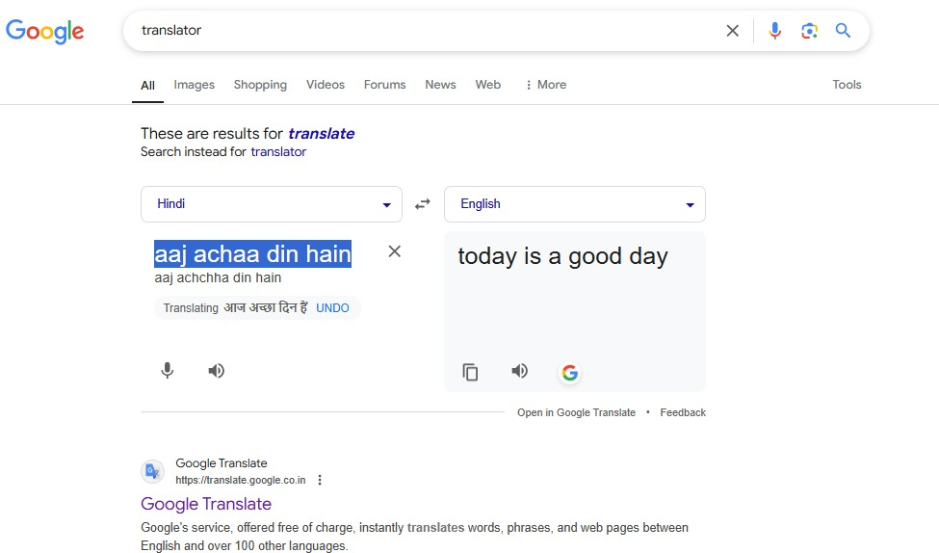
4. Finance & Marketing
Portfolio management: AI can analyze market conditions and economic indicators to help investors make better decisions and optimize their portfolios.
Predictive analytics: AI can enable predictive modeling, which can help financial organizations anticipate market trends, potential risks and customer behavior.
Speech recognition. ...
Sentiment analysis. ...
Anomaly detection. ...
Anti-money laundering. ...
Recommendations. ...
Translation. ...
Document processing. ...
Fraud mitigation with image recognition.

Slide 8
5. Quality Control
Reduces human error: AI can spot errors and not get fatigued
Improves brand reputation: AI can identify product defects before the product is sent to the customer. Example from Optical Lab
Helps meet regulations: Many parts and products must meet stringent regulations, and AI helps companies do so by flagging any compliance issues or other problems.
Reduces waste: ML can help prevent faulty ingredients and parts from entering downstream manufacturing. Removing these flawed inputs leads to fewer products that are rejected

Slide 9
6. Regulatory Compliance
It can swiftly sift through vast amounts of regulatory content to spot new requirements or updates to manage adherence to regulatory requirements. AI systems can be designed to stay updated with the latest regulatory changes, ensuring businesses remain compliant.

Slide 10
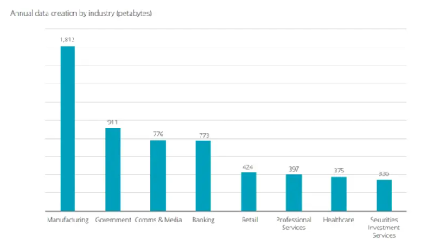
7. Automotive & Manufacturing
Autonomous Vehicles: navigating roads, avoiding obstacles, and taking crucial decisions.
Robots can autonomously pick parts, minimize human intervention, and speed up the manufacturing process.
AI in automotive manufacturing utilizes robots that alert humans in case of any unexpected machine failure, preventing any mishaps.
Generate new design
Manufacturing industry generates largest data.

Slide 11
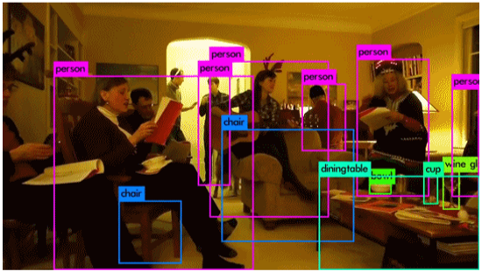
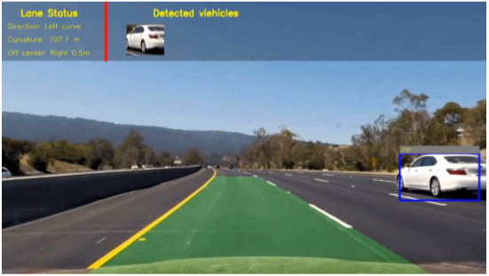
Object Recognition

Slide 12
8. Others
Walmart uses AI to forecast demand on products, evaluate previous sales data and manage inventory
Amazon cobot (collaborative robot) uses ML for order fulfillment and streamline logistics.
Travel &Tourism:
1. Use flight d/b to predict optimal hotel prices and flights while offering users personalized recommendations about the most suitable time to book a flight.
2. When a traveler is tracking a flight, it provides recommendations on whether he/she should buy it now or wait for a better price.
3. AI-powered luggage handling systems without baggage labels.
Flight forecasting
Landscape analysis: Predicting wild fires hotspots, etc
Use in smart cities: Using image analysis of road, pavements, etc. make predictions on maintenance. Also predict energy needs, etc. Controlling pollutions by making prediction based on historic data. Traffic management by controlling light depending on number of vehicles, types of vehicles, etc

Slide 13
8. Others(Mechanical Engg)
Artificial intelligence (AI) is used in mechanical engineering to improve design, manufacturing, and maintenance. AI can also help with quality control, robotics, and supply chain management.

Slide 14
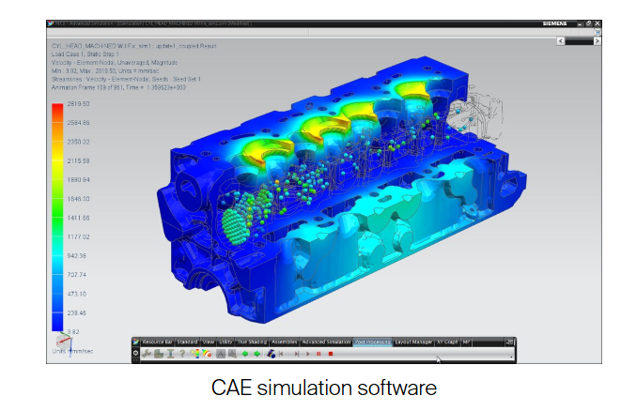
8. Others(Mechanical Engg)
1. Design
Design optimization: AI can analyze many design parameters to find optimal configurations
Design automation: AI can automate complex design tasks
Virtual reality: AI can create immersive manufacturing environments for students

Slide 15
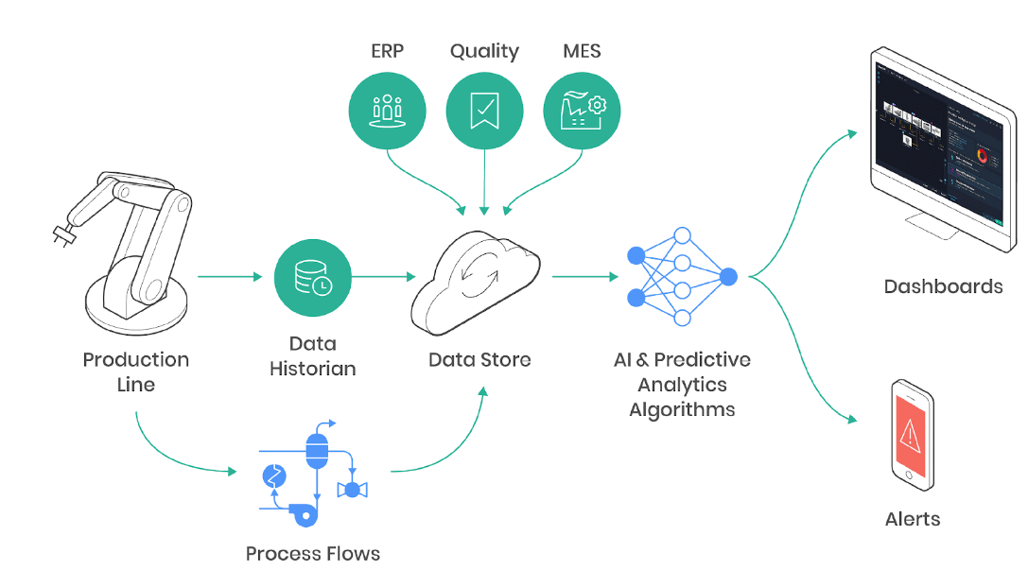
8. Others(Mechanical Engg)
2. Manufacturing
Quality control: AI can detect defects and deviations in real time
Predictive maintenance: AI can predict when machinery is likely to fail
Manufacturing process optimization: AI can identify inefficiencies and suggest improvements

Slide 16
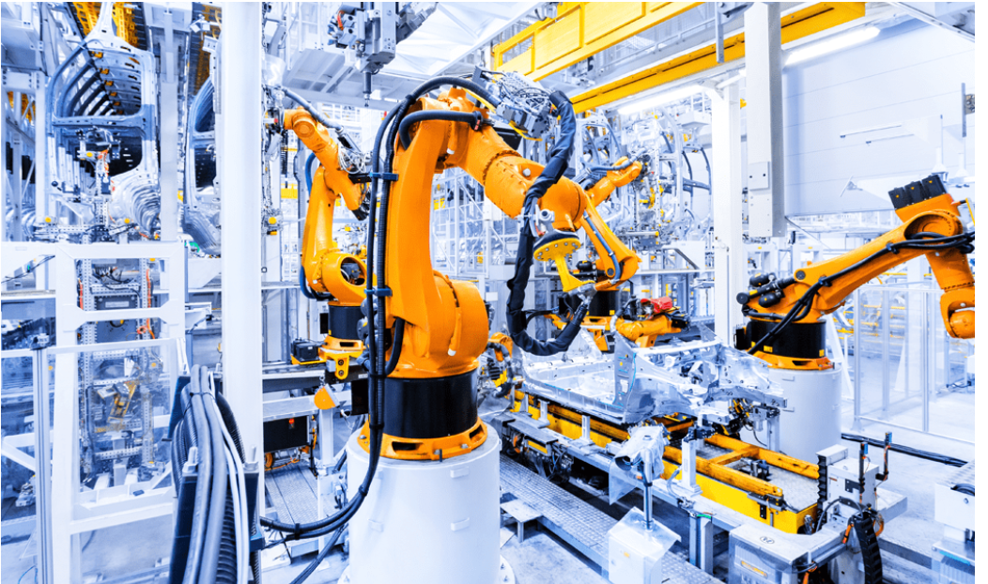
8. Others(Mechanical Engg)
3. Robotics
Robotic assembly: AI can help design robots that can perform complex tasks
Automated welding: AI can help design robots that can perform welding tasks

Slide 17
8. Others(Mechanical Engg)
For more visit:
https://www.imeche.org/news/news-article/why-mechanical-engineers-should-learn-a.i

Slide 18
8. Others(Civil Engg)
Artificial intelligence (AI) is used in civil engineering to improve efficiency, accuracy, and safety. AI can also help identify risks, optimize resources, and reduce waste.
Applications
Project planning: AI can help with scheduling, resource allocation, and project analysis
Risk identification: AI can identify potential hazards and predict maintenance needs
Geotechnical engineering: AI can improve soil analysis and decision making
Smart city development: AI can optimize resource use and improve urban services
Digital twin simulations: AI can create virtual representations of structures to help identify design flaws and test materials

Slide 19
8. Others(Civil Engg)
Benefits
Cost reduction: AI can reduce waste, optimize resources, and minimize delays
Safety improvements: AI can monitor construction sites and identify risks in real time
Enhanced efficiency: AI can automate repetitive tasks, freeing up engineers to focus on innovation
Improved accuracy: AI can eliminate human error in calculations and designs

Slide 20
Misc: Application (Example)
A group at Mount Sinai used deep learning-based AI algorithms to predict the development of diseases with 94% accuracy, including cancers of liver, rectum, and prostate
The World Bee Project is using artificial intelligence to save the bees The global bee population is in decline, and that's bad news for our planet and our food supply. In a partnership with Oracle, The World Bee Project hopes to learn how to help bees survive and thrive by gathering data through internet-of-things sensors, microphones, and cameras on hives.
Facing Emotions, AI app created by Huawei, translates emotion into short and simple sounds. The app assesses the emotion it sees on another's face to help blind people "see" the emotion of the person they are talking with. The app uses the rear camera on the phone to evaluate the nose, mouth, eyebrows and eyes, and artificial intelligence to analyze the expression on these facial features and what emotion they convey—contempt, anger, fear, disgust, sadness, happiness and surprise.
AI can also help educate and predict the impacts of climate change on different regions. Researchers from the Montreal Institute for Learning Algorithms (MILA) use GANs (generative adversarial networks) to simulate the damage of severe storms and rising sea levels.
In another effort to halt the decline of endangered species by using AI, the University of Southern California Center for Artificial Intelligence in Society uses an unmanned aerial vehicle to spot poachers and locate animals. The data collected by the drone is sent back to be analyzed by machine learning tools that use game theory to help predict poacher and animal activity. AI is also used by Wild Me and Microsoft to automatically recognize, log, and track endangered animals like whale sharks by analyzing photos people upload to the internet.
Many applications are in use already, but one we'll highlight here is the Nutrition Early Warning System (NEWS) that uses machine learning and big data to identify regions that are at increased risk of food shortages due to crop failure, rising food prices and drought.
German-based Siemens Healthineers is a leading medical technology company that integrates AI into many of its innovative technologies. One of these technologies is the AI-Rad Companion.4, a radiologist assistant that supports routine reading and measurement tasks on medical imaging. AI augments the review of medical imaging to help alleviate some of the workloads for over-taxed radiologists. Another innovation is the AI-Pathway Companion5. This tool integrates insights from pathology, imaging, lab and genetics for each patient to provide status and suggest the next steps based on the data.

Slide 21
Example of AI mistakes
Facebook’s AI systems were supercharging the spread of harmful anti-Rohingya content in Myanmar, leading to killing of Rohingya people in 2017.
In March 2024, The Markup reported that Microsoft-powered chatbot MyCity was giving entrepreneurs incorrect information that would lead to them break the law. It falsely claimed that business owners could take a cut of their workers’ tips, fire workers who complain of sexual harassment, and serve food that had been nibbled by rodents. It also claimed landlords could discriminate based on source of income.
In February 2024, Air Canada was ordered to pay damages to a passenger after its virtual assistant gave him incorrect information at a particularly difficult time.
In August 2023, tutoring company iTutor Group agreed to pay $365,000 to settle a suit brought by the US Equal Employment Opportunity Commission (EEOC). The federal agency said the company, which provides remote tutoring services to students in China, used AI-powered recruiting software that automatically rejected female applicants ages 55 and older, and male applicants ages 60 and older.
AI Hallucinations: Attorney Steven Schwartz learned when he found himself in hot water with US District Judge Kevin Castel in 2023 after using ChatGPT to research precedents in a suit against Colombian airline Avianca.
MIT Technology Review has chronicled a number of failures, most of which stem from errors in the way the tools were trained or tested. The use of mislabeled data, or data from unknown sources, was a common culprit.
ML researcher explored the use of deep learning models for diagnosing the virus. For example, Driggs’ group found that their own model was flawed because it was trained on a data set that included scans of patients that were lying down while scanned, and patients that were standing up. The patients who were lying down were much more likely to be seriously ill, so the algorithm learned to identify COVID risk based on the position of the person in the scan. A similar example includes an algorithm trained with a data set with scans of chests of healthy children. The algorithm learned to identify children, not high-risk patients.
Zillows AI algorithm led it to unintentionally purchase homes at higher prices than its current estimates of future selling prices, resulting in a $304 million inventory write-down in Q3 2021.
Amazon AI-enabled recruitment tool only recommended men

